Slide 1
OSR Model - Implementation
Inputs: 30 frames, 3 channels, 100 rows, and 150 columns (after localizing oral region and size standardization)
Training Targets: One-hot encoded representations of 1 out of all possible classes e.g. [1, 0, 0] for a 3 class system
Outputs: Arrays containing predicted probabilities of each class e.g. [0.75, 0.25, 0.25] denotes 75% probability for class 1, 25% for class 2 and 3

Slide 2
OSR Model - Implementation
Multi-class classification problem
Inputs are sequences of images; classification depends on spatial and temporal patterns
Three stage neural network approach:
Convolutional Neural Network (CNN):
- Utilizes trainable filter units to find spatial patterns within images
Recurrent Neural Network (RNN):
- Utilizes trainable memory units to find temporal patterns within sequences
Multilayer Perceptron (MLP):
- Utilizes trainable artificial neurons to find correlations between features and classes

Slide 3
OSR Model - CNN Mechanics
CNNs utilize trainable filters to find spatial patterns
Filters used for identifying features e.g. curves, edges, colours
Filters are shifted across an image, then convolved with each corresponding patch (receptive field)
Each filter-patch convolution results in a single value,
Successive convolutions eventually form activation maps
MaxPooling downsamples activation maps by replacing patch pools with max values
Activation map features utilized later on to find correlations to particular classes

Slide 4
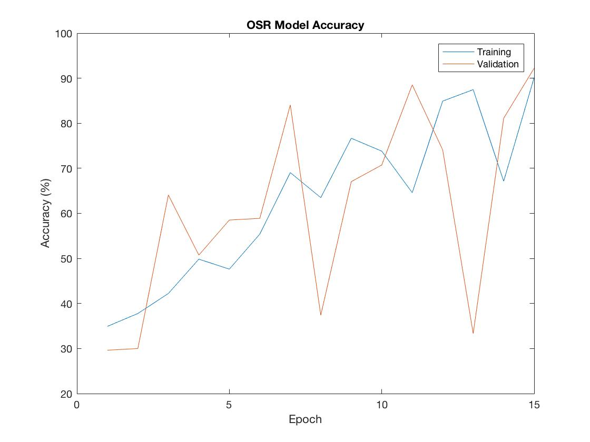
OSR Model - Performance
Trained to classify 3 classes: “yes”, “no”, “null”
Collected 90 samples, 30 samples/class
With image augmentation, boosted to 900 samples
Performed via random rotations, shifts, shears, and zooms
Partitioned data: 70% for training, 30% for validation
Over 15 epochs, ~90% accuracy achieved for training and validation phases
Training beyond 15 epochs started to cause overfitting

Slide 5
References
http://deeplearning.net/tutorial/mlp.html
http://deeplearning.net/tutorial/lenet.html
https://arxiv.org/abs/1409.1556
http://dl.acm.org/citation.cfm?id=1246450

